Slide 1
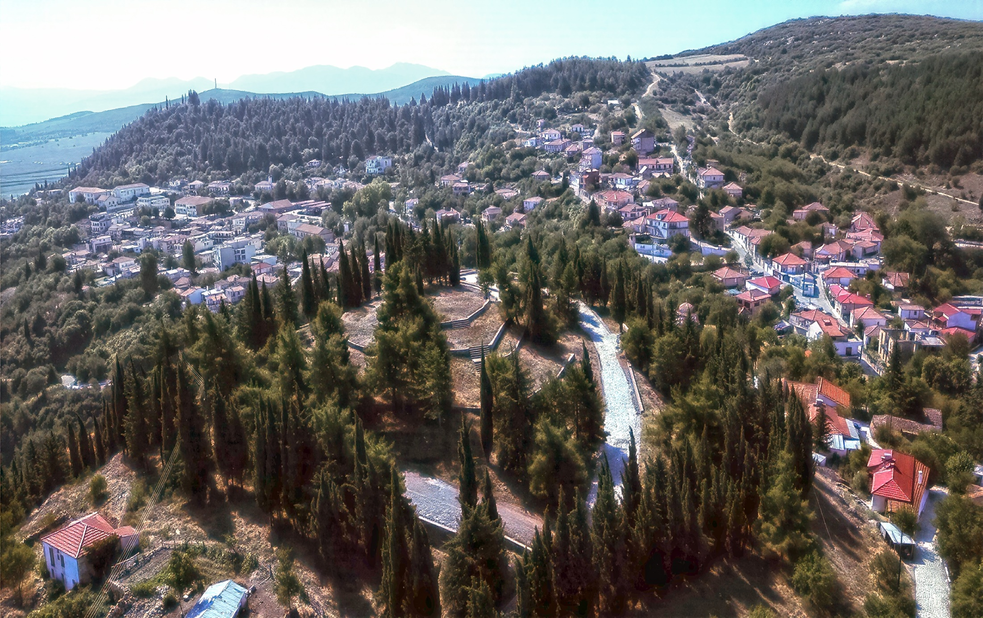



MUNICIPALITY
OF
DOMOKOS
Department of Programming, Organization, Informatics and Transparency
Kick-off meeting/SENAct Project/Erasmus⁺
2024-2-EL01-KA210-ADU-000286103-”Seniors in Action”

Slide 2
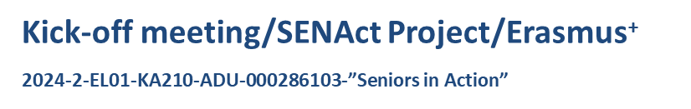
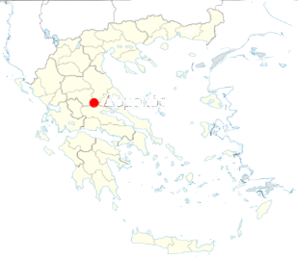


Domokos at a glance
  Location: Central Greece
  Population: 9,159
  Area: 695 km²
  32 Local Communities
Municipality of Domokos

Slide 3

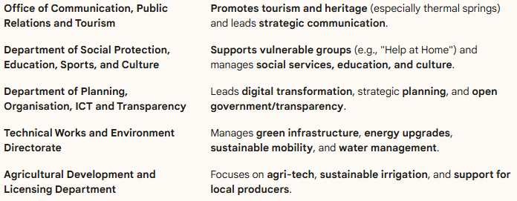
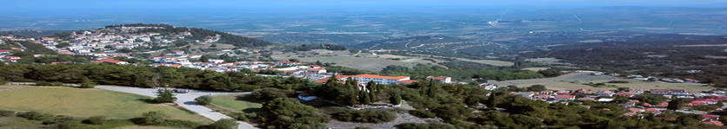

MUNICIPALITY OF DOMOKOS - Institutional profile
Department Key Focus

Slide 4

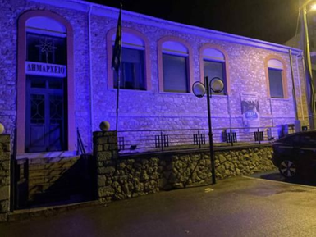
Ευχαριστούμε/ Thank you!

